Slide 1
Employer Perspective Leah Evanoski | Compensation and Benefits Manager, CSS Industries Stephanie Malsbury | Vice President, Aon Jason Krouse | SVP Eastern Region National Sales Leader, Aon Joe Mazzeo | Vice President, Aon

Slide 2

About CSS Industries
Founded in 1923
Approximately 2,000 US Eligible Employees
Corporate
Manufacturing Facilities
Warehouses
Locations throughout PA, NJ, MD, NH, SC, TX, AL, UT and TN.
CSS Industries is a consumer products company, engaged in the design, manufacture, and distribution of seasonal and all occasion social expression products.
Products support mass merchandisers, chain drug stores, supermarket chains, party stores and specialty gift shops.
Notes:
The CSS Team Roles and Responsibilities
Prior to this Open Enrollment
How were you and your team managing open enrollment prior?
Communications strategy
Enrollment systems
Enrollment Strategy
H&B
“What was the thought process on introducing VBES to CSS?”
CSS
“What motivated you to take the initial meeting with Stephanie and the VBES team to discuss this project?”

Slide 3
CSS Industries Objectives
Move to Electronic Enrollment Process
New process for everyone
Significant cultural shift for the employee population
Integration of new processes for the HR team
Communication Key
Explaining the new process to employees
Conveying benefit information
Voluntary Benefits
Supplement the current benefit offerings
Concerns
Field enrollment platform – pulling employees off the line without impacting production
Seasonal workforce
Notes:
During the initial meeting, VBES did a demonstration of Aon’s proprietary enrollment system
Focused on moving to an enrollment system
Limited funding for system
Communications
What was appealing about Aon managing the OE communications strategy
Enrollment
The Aon counselor model
Enrollment Logistics
Field/Enrollment Center/Self-service
What were the top 3 reasons you decided to introduce VBES as your enrollment strategy?

Slide 4
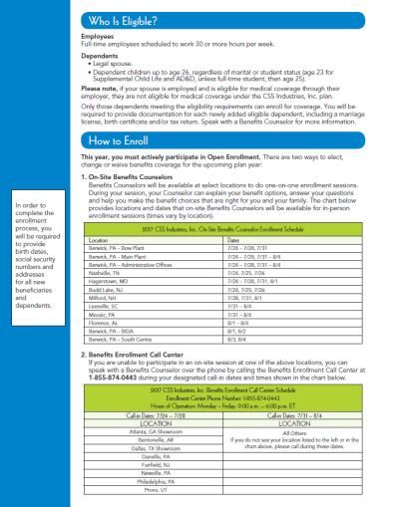
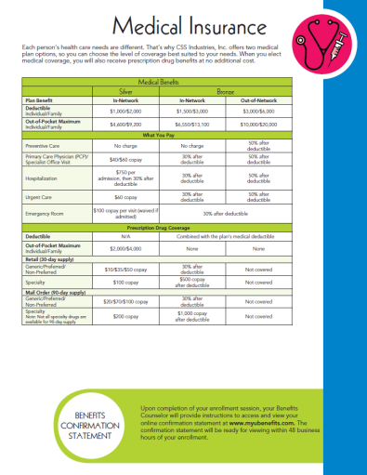




Communications Solutions
Open Enrollment Deliverables
Creative Communications Campaign
Posters
Post Card
OE Guides (4 versions)
1 translated
New Hire Guides (4 versions)
McCall Guides (2 versions)
Distribution
Guides provided as PDF
Post Cards Printed & Mailed to Homes
Posters Printed & Shipped to 12 Locations
Carriers funded $5,688.52 for the
production of the additional 3 guides,
the acquisition guide and postage.
Benefit Guide
Postcard
Poster

Slide 5
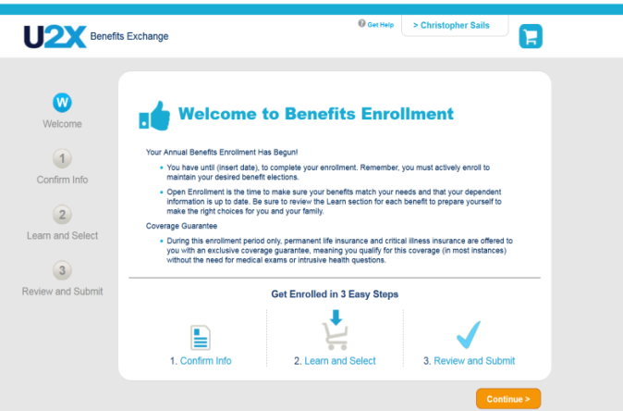
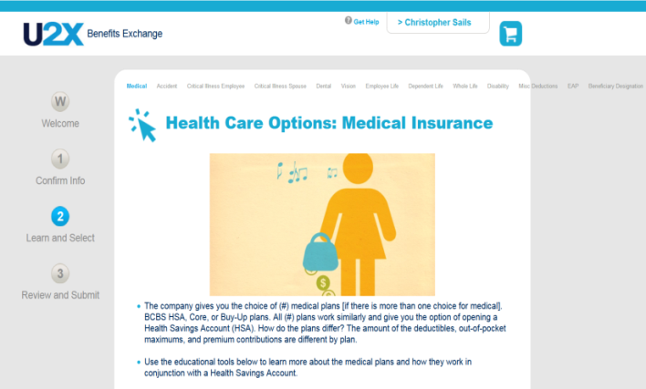
Enrollment Solution
State of the art enrollment solutions for open enrollment and new hire onboarding
U2XEnroll platform:
Designed to enroll core benefits and supplemental products, including those that require an electronic signature.
Build out of system for multiple eligibly groups, including the seasonal population
Overviews and highlights that help explain all core and voluntary plan options
Designed to enroll core benefits and supplemental products, including those that require an electronic signature.
Sent all file feeds directly to the carriers
Multiple Enrollment Methods
Call Center & Field
Field

Slide 6
What Went Well
Field and Enrollment Center Scheduling Process
Schedules were completed in a timely manner
Aon VBES and CSS resources worked well together to accommodate specific location requests
Incorporated CSS team on facility calls which helped to alleviate site concerns about the process
Overall enrollment counselor performance
Training
Overall counselor training process
Kristy, Leah and Casey attended
Interaction between parties
Communication
CSS was engaged and actively participated in the edit and approval process
Poster and postcard edit rounds completed ahead of schedule
Distribution of the poster and postcard
Enrollment Issue Resolution
Open lines of communication allowed for a prompt issue response from all parties

Slide 7

Opportunities
Plan Design Document
Initial reviews were on time, sign off was delayed
Pending carriers to provide information for voluntary products
Enrollment Center Phone Disruption
July 27 the phone lines were briefly down, service provider issue
August 7 the phone system message was not shut off & indicated the call center
Field Enrollment
Counselor visited BIDA site a day early to start enrollments, nobody was scheduled, this was a result of nobody being signed up for that day at the Bow plant.
Average meeting time, some instances of meetings taking 40+ minutes to complete, the average field enrollment was 16:27
Communications
Evolving booklet scope caused delays in executing the deliverables
Testing
Need more time for testing, condensed based on delays with the PDD approval
Post Data Files
CVS & Eye Med specification acquisition and group numbers

Slide 8
Employee Experience – Survey Results

Slide 9
Pre and Post Benefits Knowledge

Slide 10
Enrollment Metrics

Slide 11
Enrollment Metrics
Year | Total Seen* | Data Total* | Percent Seen
2017 | 1257 | 1426 | 88%
2017 Enrollment Center Participation
Number Employees Seen | 162 | Average Enrollment Time | 25:23
Number Calls Received | 227 | Average Hold Time | 4:58*
2017 Enrollment Center Participation
# Employees Seen | 1095 | # Counselors | 10
Average Session Time | 16:46 | Avg. # Enrolled Per Counselor | 109.5
*Two days call volume spiked (7/31 & 8/1) with 51 employees having hold times.
With those days removed, the average was 1:40

Slide 12
Enrollment Metrics
Core Benefit Participation
Benefit | Plan | Number Enrolled Post- Enrollment
Medical | 3 Plan Options | 833
Dental | 3 Plan Options | 975
Vision | 1 Plan Option | 508
HSA | 1 Plan Options | 29
FSA | 2 Plan Options | 120

Slide 13
CSS Open Enrollment Voluntary Benefit Analysis
Plan | % of BEE Enrolled | Deductions | Average Weekly Deduction
Accident | 34% | 482 | $3.26
Critical Illness | 36% | 701* | $4.03
Whole Life | 12% | 172 | $9.04
* 517 CSS employees enrolled, 184 SP/CH deductions

Slide 14
Mergers & Acquisitions
CSS McCall
182 employees
179 enrolled
Simplicity
139 employees
Complete Onboarding of all CSS Benefits
Within 2 weeks
Communications
2 versions
Enrollment
Field (90%) / EC
Average Time Seen: 18 minutes Field / 15 minutes EC

Slide 15
Simplicity Voluntary Benefits Analysis
Plan | % of BEE Enrolled | Deductions | Average Weekly Deduction
Accident | 32% | 45 | $3.38
Critical Illness | 27% | 57* | $3.71
Whole Life | 18% | 25 | $11.25
* 38 Simplicity employees enrolled, 19 SP/CH deductions

Slide 16
McCall Voluntary Benefit Analysis
Plan | % of BEE Enrolled | Deductions | Average Weekly Deduction
Accident | 33% | 60 | $3.68
Critical Illness | 39% | 111* | $5.01
Whole Life | 7% | 12 | $9.83
* 71 McCall employees enrolled, 40 SP/CH deductions

Slide 17
Enrollment Solution
State of the art enrollment solutions for open enrollment and new hire onboarding
U2XEnroll platform:
Designed to enroll core benefits and supplemental products, including those that require an electronic signature.
Build out of system for multiple eligibly groups, including the seasonal population
Overviews and highlights that help explain all core and voluntary plan options
Designed to enroll core benefits and supplemental products, including those that require an electronic signature.
Sent all file feeds directly to the carriers
Multiple Enrollment Methods
Call Center & Field
Field

Slide 18
What Went Well
Field and Enrollment Center Scheduling Process
Schedules were completed in a timely manner
Aon VBES and CSS resources worked well together to accommodate specific location requests
Incorporated CSS team on facility calls which helped to alleviate site concerns about the process
Overall enrollment counselor performance
Training
Overall counselor training process
Kristy, Leah and Casey attended
Interaction between parties
Communication
CSS was engaged and actively participated in the edit and approval process
Poster and postcard edit rounds completed ahead of schedule
Distribution of the poster and postcard
Enrollment Issue Resolution
Open lines of communication allowed for a prompt issue response from all parties

Slide 19
Challenges & Opportunities
Plan Design Document
Initial reviews were on time, sign off was delayed
Pending carriers to provide information for voluntary products
Enrollment Center Phone Disruption
July 27 the phone lines were briefly down, service provider issue
August 7 the phone system message was not shut off & indicated the call center
Field Enrollment
Counselor visited BIDA site a day early to start enrollments, nobody was scheduled, this was a result of nobody being signed up for that day at the Bow plant.
Average meeting time, some instances of meetings taking 40+ minutes to complete, the average field enrollment was 16:27
Communications
Evolving booklet scope caused delays in executing the deliverables
Testing
Need more time for testing, condensed based on delays with the PDD approval
Post Data Files
CVS & Eye Med specification acquisition and group numbers

Slide 20
Employee Experience – Survey Results

Slide 21
Pre and Post Benefits Knowledge

Slide 22
Enrollment Metrics

Slide 23
Enrollment Metrics
Year | Total Seen* | Data Total* | Percent Seen
2017 | 1257 | 1426 | 88%
2017 Enrollment Center Participation
Number Employees Seen | 162 | Average Enrollment Time | 25:23
Number Calls Received | 227 | Average Hold Time | 4:58*
2017 Enrollment Center Participation
# Employees Seen | 1095 | # Counselors | 10
Average Session Time | 16:46 | Avg. # Enrolled Per Counselor | 109.5
*Two days call volume spiked (7/31 & 8/1) with 51 employees having hold times.
With those days removed, the average was 1:40

Slide 24
Enrollment Metrics
Core Benefit Participation
Benefit | Plan | Number Enrolled Post- Enrollment
Medical | 3 Plan Options | 833
Dental | 3 Plan Options | 975
Vision | 1 Plan Option | 508
HSA | 1 Plan Options | 29
FSA | 2 Plan Options | 120

Slide 25
CSS Open Enrollment Voluntary Benefit Analysis
Plan | % of BEE Enrolled | Deductions | Average Weekly Deduction
Accident | 34% | 482 | $3.26
Critical Illness | 36% | 701* | $4.03
Whole Life | 12% | 172 | $9.04
* 517 CSS employees enrolled, 184 SP/CH deductions

Slide 26
Mergers & Acquisitions
CSS McCall
182 employees
179 enrolled
Simplicity
139 employees
Complete Onboarding of all CSS Benefits
Within 2 weeks
Communications
2 versions
Enrollment
Field (90%) / EC
Average Time Seen: 18 minutes Field / 15 minutes EC

Slide 27
Simplicity Voluntary Benefits Analysis
Plan | % of BEE Enrolled | Deductions | Average Weekly Deduction
Accident | 32% | 45 | $3.38
Critical Illness | 27% | 57* | $3.71
Whole Life | 18% | 25 | $11.25
* 38 Simplicity employees enrolled, 19 SP/CH deductions

Slide 28
McCall Voluntary Benefit Analysis
Plan | % of BEE Enrolled | Deductions | Average Weekly Deduction
Accident | 33% | 60 | $3.68
Critical Illness | 39% | 111* | $5.01
Whole Life | 7% | 12 | $9.83
* 71 McCall employees enrolled, 40 SP/CH deductions

Slide 29
Q & A

